Slide 1
MODULE 2
Initiating Projects:
How to get a project started
Selecting project strategically
Project selection models (Numeric /Scoring Models and Non-numeric models)
Project portfolio process
Project sponsor and creating charter
Project proposal
Effective project team, Stages of team development & growth (forming, storming, norming &performing), team dynamics

Slide 2
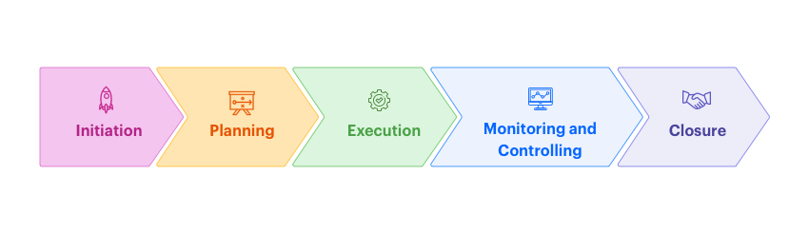

Slide 3
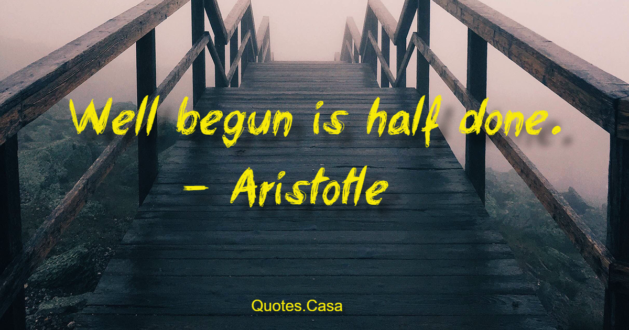

Slide 4
How to get a project started
The accomplishment of important tasks and goals in organizations today is being achieved through the use of projects. The phrases we hear “management by projects” and “project management maturity,” reflect this increasing trend in our society.
Project initiation begins with the judicious selection of the organization’s projects to align them with the organization’s overall strategy.
Evaluate and select projects that contribute to the organization’s strategy.

Slide 5




Slide 6
Selecting project strategically

Slide 7
Project selection criteria
When a firm chooses a project selection model, the following criteria are most important.
1. Realism: The model should reflect the reality of the firm’s decision situation, especially the multiple objectives of both the firm and its managers, bearing in mind that without a common measurement system, direct comparison of different projects is impossible. The model should also take into account the realities of the firm’s limitations on facilities, capital, personnel, and so forth, and include factors that reflect project technical and market risks: performance, cost, time, customer rejection, and implementation.

Slide 8
2. Capability: The model should be sophisticated enough to deal with the relevant factors: multiple time periods, situations both internal and external to the project (e.g., strikes, interest rate changes), and so on.
3. Flexibility: The model should give valid results within the range of conditions that the
firm might experience. It should be easy to modify in response to changes in the firm’s environment; for example, tax law changes, new technological advancements that alter risk levels, and, above all, organizational goal changes.
4. Ease of use: The model should be reasonably convenient, not take a long time to execute, and be easy to use and understand. It should not require special interpretation, data that are difficult to acquire, excessive personnel, or unavailable equipment.
5. Cost: Data-gathering and modeling costs should be low relative to the cost of the project and less than the potential benefits of the project. All costs should be considered, including the costs of data management and of running the model. We would add the following sixth criterion.
6. Easy computerization: It should be easy and convenient to gather and store the information in a computer database, and to manipulate data in the model through use of a widely available, standard computer package such as Excel.

Slide 9
The project initiation phase generally describes a project.
Opportunities or reasons for the project
Project objectives
Assembling a team
Defining business case (defining project in detail)
Project scope, time and cost

Slide 10
Determination of the objective of a project
A number of factors should be taken into account when determining the objective, for example:
Market needs (for example, production of digital content).
Institutional needs (educational institution develops a new teaching tool for reducing teaching costs).
Customers needs (an ICT company offers to an airport to set up a WiFi network for in a waiting room).
Technological opportunities (producing videogames after introduction of high performance personal computers).
Social need (public Internet access points in remote areas).
Legislation (web based support system on handling property rights for content developers).
A clear objective is necessary not only for decision-makers but for getting support by the project partners and for forming project team.

Slide 11
The objective and its formulation
It is recommended to apply the SMART principle. According this, the objective and its formulation should be:
Simple. Everybody who has basic knowledge of the area should understand what exactly the project is aiming to complete.
Measurable. It should be possible to measure to what extent the project goal has been achieved.
Agreed. The outcome should meet the customers/end users needs, should solve some problems. Agreement bases on information exchange with the customers and as a side effect, increases devotion of the project team.
Realistic. The objective should correspond to the resources available. One should not plan outcomes or activities that require much more knowledge than the project team actually has; this can cause an unexpected need to perform additional research or education. When nevertheless some tasks that should be performed where there is a lack of competence, then it is recommended to consider the possibility to acquire necessary goods and services from outside the performing organization.
Timed. Is a planned duration sufficient for achieving the project goal? What possible compensation mechanisms are available, in case unexpected delays will occur.

Slide 12
Project Selection And Criteria Of Choice
Project selection is the process of evaluating proposed projects or groups of projects, and then choosing to implement some set of them so that the objectives of the parent organization will be achieved.
Project selection is only one of many decisions associated with project management. To deal with all of these problems, we use models. We need such models because they abstract the relevant issues about a problem from the mass of detail in which the problem is embedded.

Slide 13
Non- Numeric Models
There are two basic types of project selection models, numeric and nonnumeric. Both are widely used. Many organizations use both at the same time, or they use models that are combinations of the two.
Non- Numeric Models for Project Selection:
The Sacred Cow: In this case the project is suggested by a senior and powerful official in the organization.
The Operating Necessity: If the project is required in order to keep the system operating.
The Competitive Necessity: Project is taken up to maintain competitive position in the market
The Product Line Extension: In this case, a project to develop and distribute new products would be judged on the degree to which it fits the firm’s existing product line, fills a gap, strengthens a weak link, or extends the line in a new, desirable direction.
Comparitive Benefit Model: For this situation, assume that an organization has many projects to consider, perhaps several dozen. Senior management would like to select a subset of the projects that would most benefit the firm

Slide 14
Numeric Models
Profit/Profitability Models
Payback Period
Discounted Cash Flow
Internal Rate of Return
Profi tability Index
Scoring Models
Unweighted 0–1 Factor Model
Unweighted Factor Scoring Model

Slide 15
Problem 1
Two new Internet site projects are proposed to a young start-up company. Project A will cost $250,000 to implement and is expected to have annual net cash flows of $75,000. Project B will cost $150,000 to implement and should generate annual net cash flows of $52,000. The company is very concerned about their cash flow. Using the payback period, which project is better, from a cash flow standpoint?

Slide 16
Problem 2 (a)
A four-year financial project has net cash flows of $20,000; $25,000; $30,000; and $50,000 in the next four years. It will cost $75,000 to implement the project. If the required rate of return is 0.2, conduct a discounted cash flow calculation to determine the NPV.

Slide 17
Problem 2 (b)
What would happen to the NPV of the above project if the inflation rate was expected to be 4 percent in each of the next four years?

Slide 18
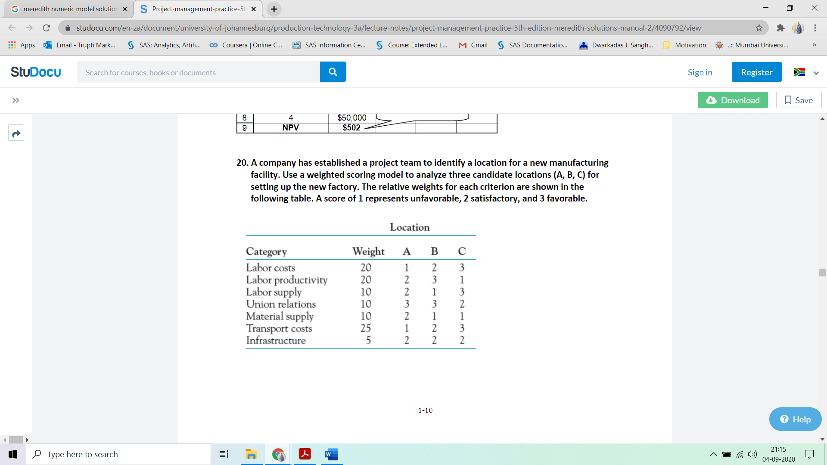
Problem 3

Slide 19
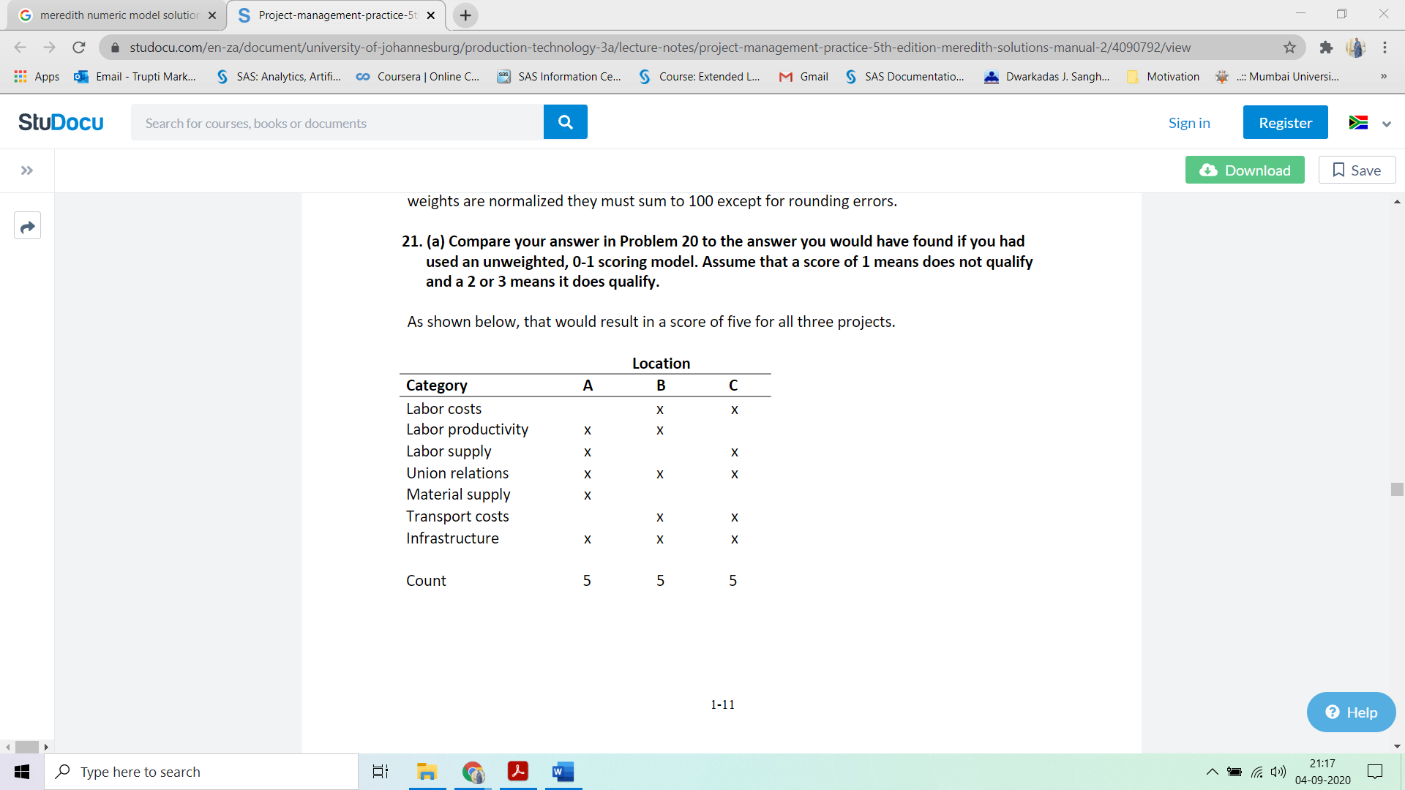
3

Slide 21
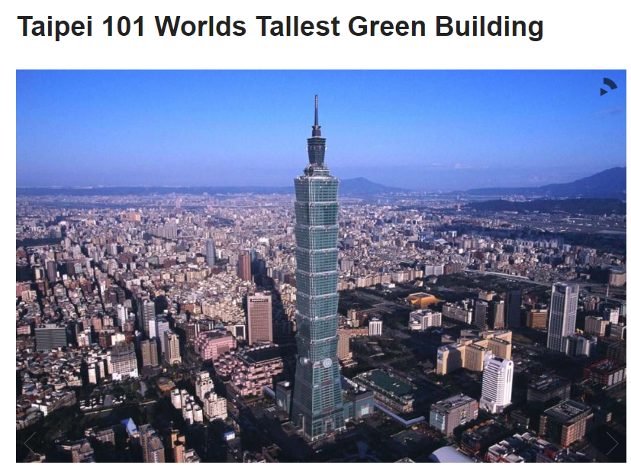
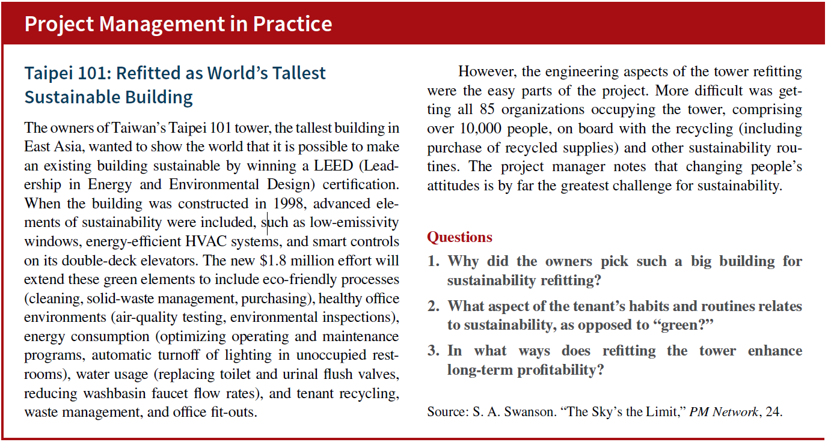

Slide 22
The owners of the building wanted to show the world that was possible to make an existing building sustainable. The owners had the LEED certification to make the big building in the world. They showed the world by picking the big building in East Asia. The LEED certification was helpful to consider on the building sustainable. Refitted is the tallest building rather than other building in the world. In addition, the owners made the most effective strategy and plan to build the big building in an effective way. It is possible to make an existing building sustainable rather than a new building. Finally, it can be analyzed that the owners had focused on the possible outcomes to build the existing building in the world.

Slide 23
PROJECT PORTFOLIO PROCESS (PPP)
It is the project selection process described previously by detailing an eight-step process that holds promise for improving an organization’s project management maturity and at the same time ties the projects more closely to the organization’s goals.
Step 1: Establish a Project Council
Step 2: Identify Project Categories & Criteria
Step 3: Collect Project Data
Step 4: Assess Resource Availability
Step 5: Reduce Project and Criteria Set
Step 6: Prioritize Projects within Categories
Step 7: Select the projects to be funded and held in reserve
Step 8: Implement the Process

Slide 24
Project Portfolio Process
A project may be managed in three separate scenarios: as a stand-alone project (outside of a portfolio or program), within a program, or within a portfolio.
Project managers interact with portfolio and program managers when a project is within a program or portfolio.
For example, multiple projects may be needed to accomplish a set of goals and objectives for an organization. In those situations, projects may be grouped together into a program.
A program is defined as a group of related projects, subsidiary programs, and program activities managed in a coordinated manner to obtain benefits not available from managing them individually

Slide 25
Project Portfolio Process
A portfolio is defined as projects, programs, subsidiary portfolios, and operations managed as a group to achieve strategic objectives.
Portfolio management is defined as the centralized management of one or more portfolios to achieve strategic objectives. The programs or projects of the portfolio may not necessarily be interdependent or directly related.
Attempts to link project to goals and strategy of organisation
Occurs throughout lifecycle of project
PPP also meant for monitoring and controlling strategic projects
Shutting down projects before completion because their risks have become excessive, their costs have escalated out of line with their expected benefits, another (or a new) project does a better job of supporting the goals

Slide 27
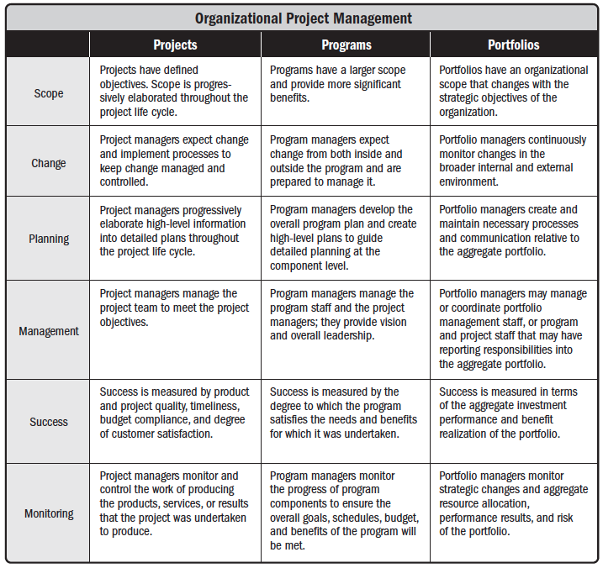

Slide 28
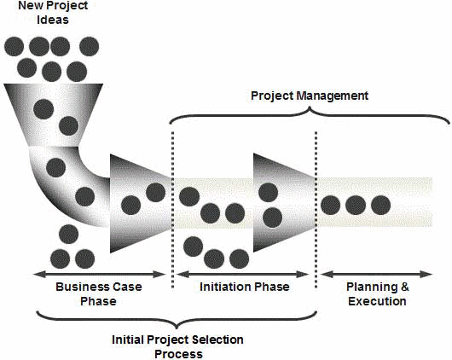

Slide 29
Project Portfolio Process (PPP)
Step 1: Establish a Project Council
Step 2: Identify Project Categories & Criteria
Step 3: Collect Project Data
Step 4: Assess Resource Availability
Step 5: Reduce Project and Criteria Set
Step 6: Prioritize Projects within Categories
Step 7: Select the Projects to be funded and held reserve
Step 8: Implement the Process

Slide 30
1. Establish a Project Council
To establish and articulate strategic direction of projects
Also responsible for allocating funds, resources and skills
Council
Senior Managers
the project managers of major projects;
the head of the Project Management Office, if one exists;
particularly relevant general managers;
those who can identify key opportunities and risks facing the organization; and
anyone who can derail the progress of the PPP later on in the process.

Slide 31
2. Identify Project Categories & Criteria
Various projects categories are identified
So that it will be spread appropriately to meet various goals of the organisation
Discriminate between good and better projects
Criteria's are weighted to reflect their relative importance
First step is to list goals of each existing and proposed project

Slide 32
Aggregate Project Plan
Categories proposed by Weelwright and Clark
Derivative Projects
Platform Projects
Breakthrough Projects
R&D Projects

Slide 33
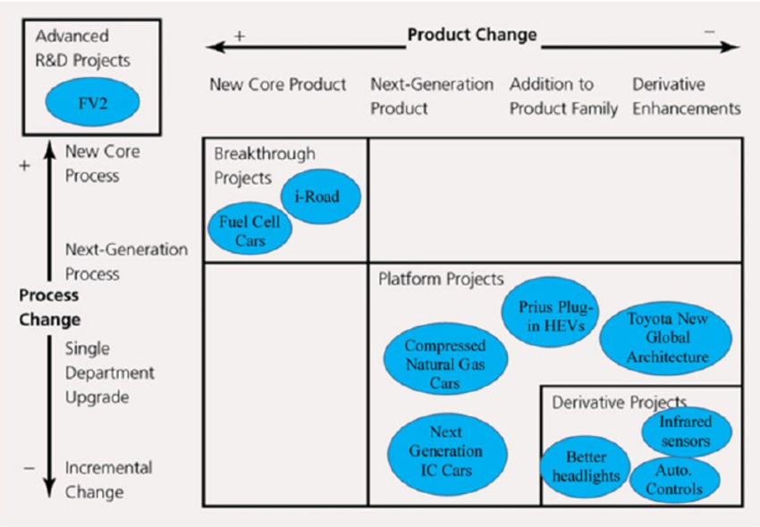
Aggregate Project Plan

Slide 35
Aggregate project plan can be used to
Views the mix of projects within each category
Analyse and adjust mix of projects within each category
Assess the resource demands
Identify and adjust the gaps in categories, sizes and timing of projects
To identify workforce requirement

Slide 36
3. Collect Project Data
For existing and proposed project collect data appropriate to the category criteria
Timing, date, duration, expected benefits and resource needed
Use project plan, schedule of project activities, past experience, expert opinion to get good estimate of the data
Identify any projects that can be deferred to a later time period, those that must precede or follow other projects, those that support other projects or should be done in conjunction with them, those that can be outsourced, and other such special aspects of the projects.
Use criteria score limits to screen out the weaker projects
Escalating costs
Changed organisational goals
Changed regulations or law

Slide 37
4. Assess Resource Availability
Assess the availability of both internal and external resources by type, department and timing.
Council will be trying to balance aggregate project resource needs over future periods with resource availabilities

Slide 38
5. Reduce the Project and Criteria Set
Whether the project support organisational goals
Whether required competence exits in the organisation
Profitability
Risk
Resources
If the projects has slipped from its objectives
If the project dominated by another existing or proposed project

Slide 39
6. Prioritise the Projects within Categories
Apply score and criterion weights to rank projects
Reconsider the projects in terms of their benefits first and their resource costs second.
Council summarizes return from the project to the organization by category.

Slide 40
7. Select the Projects to be funded and held reserve
Determine the mix of projects across various categories
Leave 20-25 % of the organisations resources for new opportunities, crisis in existing project, errors in estimate etc.
Rank the projects in categories.
Commit fewer projects but allocate sufficient fund for project selection.

Slide 41
8. Implement the Process
First step is to make the results of PPP widely known.
Document the reasons for project cancellation, non selection etc.
Commitment of top management by supporting the process and the results.
Process must be repeated on a regular basis, the process should be flexible and improved continuously.

Slide 42
Project sponsor
The Project Sponsor is the individual (often a manager or executive) with overall accountability for the project.
Roles
Responsibilities

Slide 43
Project Sponsor
Role
During the life of any project, business circumstances may change considerably, making it impossible for the Project Manager to carry out his/her job. Examples are such things as changes of policy, adverse business conditions, etc. In such cases the Project Sponsor is responsible for recognising and reacting to any such circumstances.
The Project Sponsor acts as the representative of the organisation, and plays a vital leadership role through:
• providing 'championship' for the project, selling and marketing the project throughout the organisation
• providing business expertise and guidance to the Project Manager
• acting as the link between the project, the business community and perhaps most importantly, management decision making groups
• acting as an arbitrator and making decisions that may be beyond the authority of the Project Manager
• acting as chairperson of the Steering Committee.

Slide 44
Project Sponsors Responsibilities
Typically the Project Sponsor will be responsible for:
ensuring that the business need is valid and correctly prioritized
ensuring that the project is properly launched
ensuring that the project remains a viable business proposition
ensuring changes to the project are properly managed
ensuring risks are managed
establishing the project organization, roles and reporting structure
ensuring the project is under control
approving key project deliverables
initiating project reviews and supporting the process of review
resolving issues (typically competition for resources and priority clashes) that are beyond the control of the Project Manager
resolving conflict and removing obstacles to progress
overall quality of the project, both the methods used to develop it and the end product.

Slide 45
Project proposal
The set of documents submitted for evaluation is called the project proposal
Several issues are faced by firms preparing proposals, particularly firms in the aerospace, construction, defense, and consulting industries. These are:
1. Which projects should be bid on?
2. How should the proposal-preparation process be organized and staffed?
3. How much should be spent on preparing proposals for bids?
4. How should the bid prices be set? What is the bidding strategy? Is it ethical?
Generally, these decisions are made on the basis of their overall expected values, perhaps as reflected in a scoring model.
In-house proposals
Proposals submitted to outside clients or agencies. Eg: Department of Defense. Request for Proposal (RFP) or Request for Quotation (RFQ)—more specifi cally, in the Technical Proposal Requirements (TPR) that is part of the RFP or RFQ.

Slide 46
All proposals should begin with a short summary statement (an “Executive Summary”)
covering the fundamental nature of the proposal in minimally technical language, as well as
the general benefits that are expected.
All proposals should be accompanied by a “cover letter.” . The cover letter is a key marketing document and is worthy of careful attention.
In addition to the Executive Summary and the cover letter, every proposal should deal with four distinct issues:
(1) the nature of the technical problem and how it is to be approached;
(2) the plan for implementing the project once it has been accepted;
(3) the plan for logistic support and administration of the project; and
(4) a description of the group proposing to do the work, plus its past experience in similar work.

Slide 47
Creating a project charter
Project Charter refers to a statement of objectives in a project. This statement also sets out detailed project goals, roles and responsibilities, identifies the main stakeholders, and the level of authority of a project manager.
The Role of Project Charter
It documents the reasons for undertaking the project.
Outlines the objectives and the constraints faced by the project.
Provides solutions to the problem in hand.
Identifies the main stakeholders of the project.

Slide 48
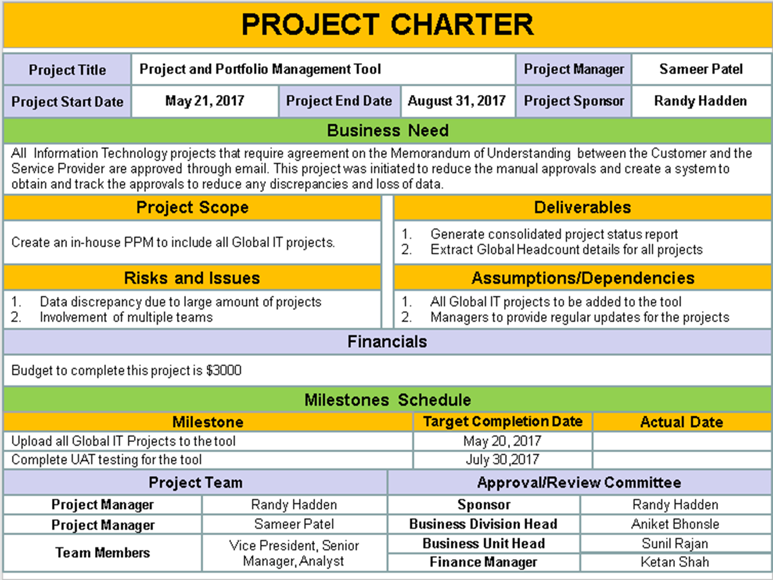

Slide 49
Benefits of Project Charter
Following are the prominent benefits of Project Charter for a project:
• It improves and paves way for good customer relationships.
• Project Charter also works as a tool that improves project management processes.
• Regional and headquarter communications can also be improved to a greater extent.
• By having a project charter, project sponsorship can also be gained.
• Project Charter recognizes senior management roles.
• Allows progression, which is aimed at attaining industry best practices.

Slide 50
Elements in Project Charter
Since project charter is a project planning tool, which is aimed at resolving an issue or an opportunity, the below elements are essential for a good charter project.
For an effective charter project, it needs to address these key elements:
• Identity of the project.
• Time: the start date and the deadline for the project.
• People involved in the project.
• Outlined objectives and set targets.
• The reason for a project charter to be carried out, often referred to as 'business case'.
• Detailed description of a problem or an opportunity.
• The return expected from the project.
• Results that could be expected in terms of performance.
• The expected date that the objectives is to be achieved.
• Clearly defined roles and responsibilities of the participants involved.
• Requirement of resources that will be needed for the objectives to be achieved.
• Barriers and the risks involved with the project.
• Informed and effective communication plan.

Slide 51
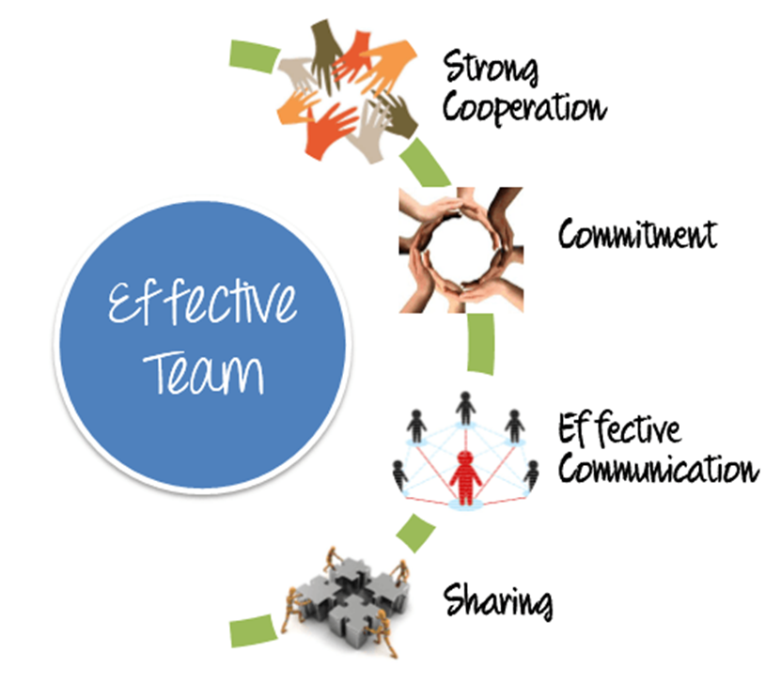
Effective project team
Project managers require the skills to identify, build, maintain, motivate, lead, and inspire project teams to achieve high team performance and to meet the project's objectives.
Teamwork is a critical factor for project success, and developing effective project teams is one of the primary responsibilities of the project manager.
Project managers should create an environment that facilitates teamwork and continually motivates the team by providing challenges and opportunities, providing timely feedback and support as needed, and recognizing and rewarding good performance.
High team performance can be achieved by employing these behaviors:
Using open and effective communication,
Creating team-building opportunities,
Developing trust among team members,
Managing conflicts in a constructive manner,
Encouraging collaborative problem solving, and
Encouraging collaborative decision making.

Slide 52
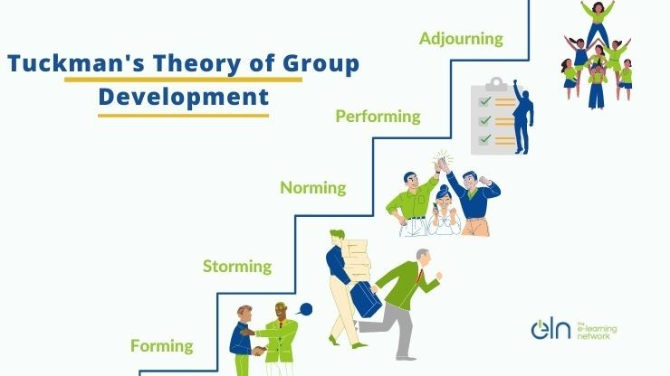
Stages of team development

Slide 53
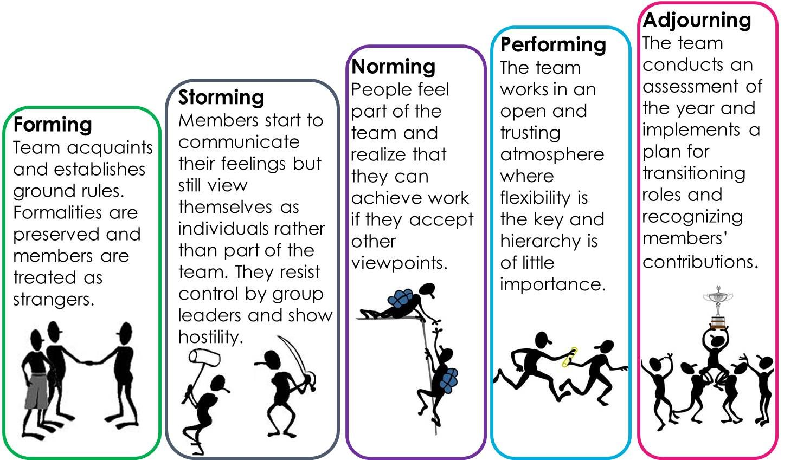

Slide 54
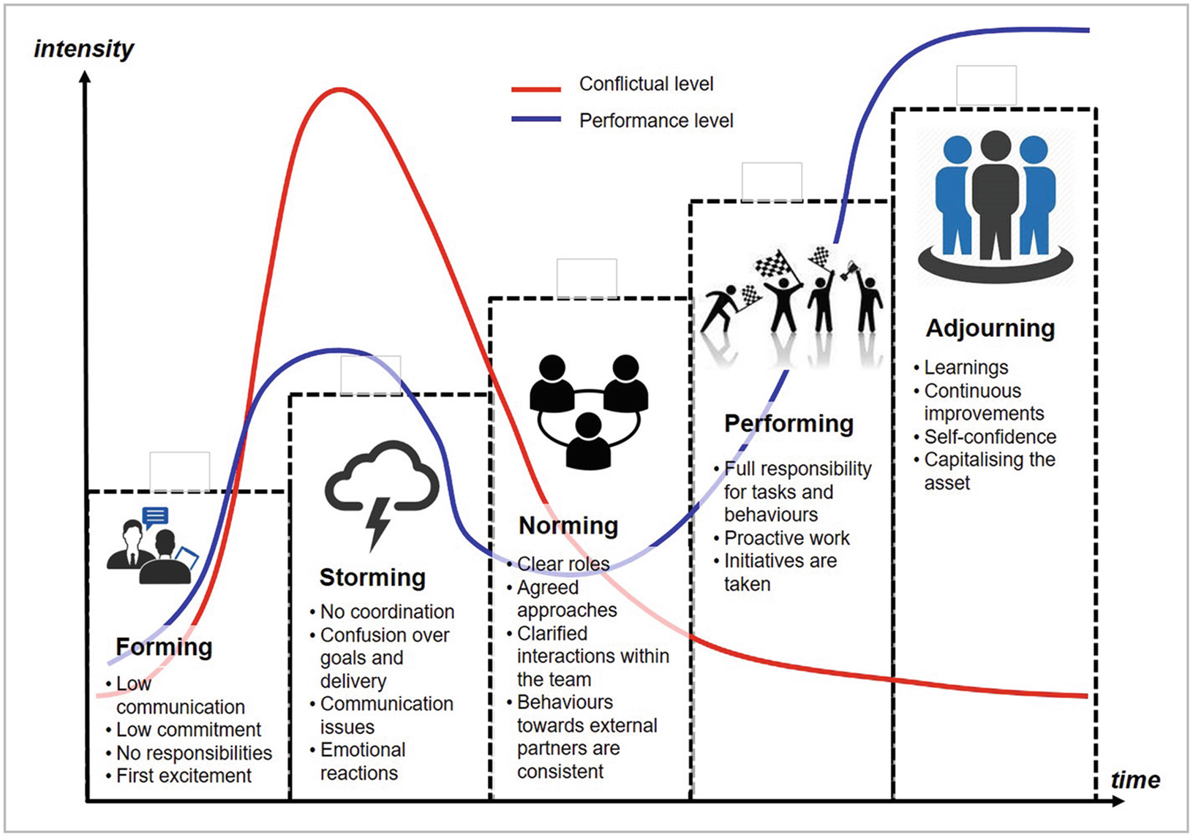

Slide 55
Stages of team development
Forming. This phase is where the team members meet and learn about the project and their formal roles and responsibilities. Team members tend to be independent and not as open in this phase.
Storming. During this phase, the team begins to address the project work, technical decisions, and the project management approach. If team members are not collaborative or open to differing ideas and perspectives, the environment can become counterproductive.
Norming. In this phase, team members begin to work together and adjust their work habits and behaviors to support the team. The team members learn to trust each other.
Performing. Teams that reach the performing stage function as a well-organized unit. They are interdependent and work through issues smoothly and effectively.
Adjourning. In this phase, the team completes the work and moves on from the project. This typically occurs when staff is released from the project as deliverables are completed or as part of the Close Project or Phase process.

Slide 56
Team Dynamics
Team dynamics are the unconscious, psychological forces that influence the direction of a team’s behaviour and performance.
Team dynamics are created by the nature of the team’s work, the personalities within the team, their working relationships with other people, and the environment in which the team works.
Team dynamics can be good - for example, when they improve overall team performance and/or get the best out of individual team members.
They can also be bad - for example, when they cause unproductive conflict, demotivation, and prevent the team from achieving its goals.
Notes:
Team dynamics can be good - for example, when they improve overall team performance and/or get the best out of individual team members. They can also be bad - for example, when they cause unproductive conflict, demotivation, and prevent the team from achieving its goals.

Slide 57
The Importance of Team Dynamics in Project Management
Communication- Communication is vital for a successful project. The project leader must give directions and advice clearly to ensure the team understands its task, and the team must feel comfortable relaying problems and inquiries to each other and the manager.
Motivation- Motivated workers are excited to contribute. Unmotivated workers, at best, do just enough to avoid criticism. Use incentives to motivate your team to work together well.
Innovation- Innovation can be an emergent group phenomenon, meaning it arises from the communication dynamics of the entire team, not just from the rare brilliant individual.
Efficiency- Effective team dynamics allow each participant to serve in her best capacity. The various skills of the team members complement one another, leading to speedy, efficient work.
Better Results- Establishing an effective team involves defining a clear purpose, goals, dependencies and accountability
More Commitment-When a team member feels valued by the project manager and other team members, her morale and confidence go up. She tends to feel more commitment to the project and is likely to contribute more discussions, task completion and other project activities.
Less Conflict -Team members who disrespect each other tend to focus on their differences, not their commonalities. Varying cultural backgrounds and experiences may lead team members to make judgments and jump to erroneous conclusions
More Trust- Establishing trust takes time. Team members may resist exposing their weaknesses and hide deficiencies. An effective project manager works to assess the team's strengths and limitations.

Slide 58
